Slide 1
DATA STRUCTURES
Stack
30
TOP
A simple look at LIFO and my C++ implementation
20
C++ Programming | Lab 01
10
Arya Desai
LIFO

Slide 2
01 • IDEA
02
What is a stack?
The easiest way to think about a stack is a pile.
You add and remove things from the same end — the top.
For me, the easiest way to picture a stack is a pile of plates.
TOP
Last In
First Out
LIFO
So the newest item is the first one we take out.
Example: a stack of plates
I can only add or remove a plate from the top.

Slide 3
02 • OPERATIONS
03
The main stack operations
push()
pop()
peek()
add to the top
remove the top item
look at the top
isEmpty()
isFull()
displayAll()
check if it has no items
check if the array is full
show the current stack
In the code, `top` keeps track of the current top position.

Slide 4
03 • LIFO
04
Push & pop in one picture
POP
PUSH
TOP → 40
TOP → 40
put 40 on top
40
TOP
40
30
30
30
30
20
→
20
20
→
20
10
10
10
10
before
after
before
after
40 is removed first
Last in → first out
My example: I pushed 10, 20, 30, then popped 30 first.

Slide 5
04 • ERRORS
05
What are overflow and underflow?
OVERFLOW
UNDERFLOW
The stack is full, so another push cannot fit.
The stack is empty, so there is nothing to remove.
50
40
30
20
10
push(60) → Stack Overflow!
pop() → Stack Underflow!

Slide 6
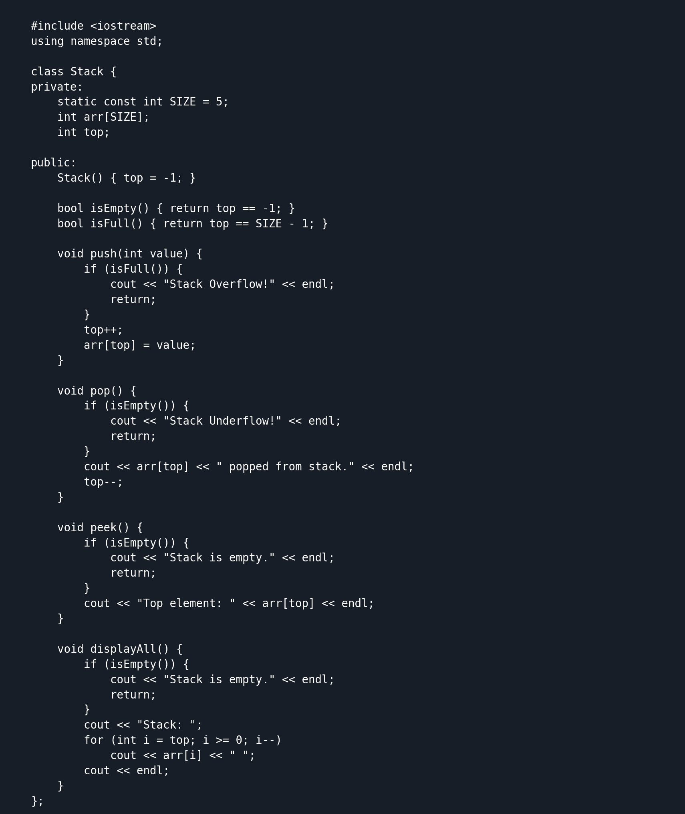
05 • IMPLEMENTATION
06
How I built the stack in C++
My C++ implementation
My approach
A key part of the class
I used a static array of 5 spaces and a `top` variable that starts at -1.
• Use a static array with 5 spaces.
int arr[SIZE];
int top = -1;
bool isEmpty() {
return top == -1;
}
bool isFull() {
return top == SIZE - 1;
}
void push(int value) {
if (isFull()) {
cout << "Stack Overflow!" << endl;
return;
}
top++;
arr[top] = value;
}
What I coded
• Start top at -1.
• push() adds a value at the top.
• pop() removes the current top value.
• push() moves top up and stores a value.
• peek() shows the top without removing it.
• pop() removes the current top.
• isFull() and isEmpty() prevent invalid operations.
• Check full/empty before changing the stack.
Static array implementation • no STL stack used
This is the same code I used for the Terminal test on the next slide.

Slide 7
06 • DESIGN CHOICE
07
Advantages & limitations
Advantages
Limitations
• Simple to implement using an array.
• The array has a fixed size.
• Push and pop are quick because they work at the top.
• Trying to push when it is full causes overflow.
• Contiguous array storage makes the structure straightforward to understand.
• Unused array positions cannot be expanded automatically.
For my program, the stack size is fixed at 5.
C++ Programming • Lab 01
Arya Desai

Slide 8
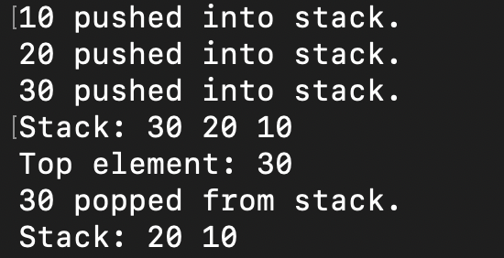
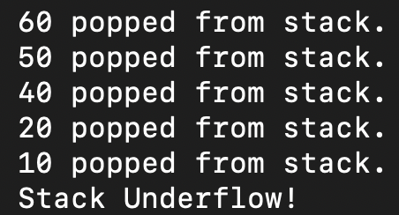
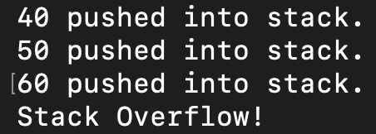
06 • RUN
07
My program actually ran
I tested the stack in Terminal after setting up the C++ compiler.
I tested normal operations first, then deliberately tested a full and empty stack.
My actual Terminal output
LIFO
OVERFLOW
UNDERFLOW
30 popped first → LIFO
60 pushed → Overflow
extra pop → Underflow
The output includes normal operations, overflow, and underflow.

Slide 9
07 • RESULTS
08
What happened in my test?
1
Push
10, 20, 30 are added.
The most recent function call is handled first, then the program returns to the previous call.
The newest action can be undone first, which follows the LIFO pattern.
2
Peek + pop
30 is on top, then 30 is removed.
3
Fill it
40 and 50 fill the remaining spaces.
Stacks can hold intermediate values while an expression is processed.
Recent pages can be revisited in reverse order because the latest page is handled first.
4
Test errors
An extra push gives Overflow; a final pop gives Underflow.

Slide 10
08 • USES
09
Where can stacks be useful?
Function calls
Undo / redo
Programs keep track of active calls.
Recent actions can be reversed.
Expression evaluation
Browser navigation
Stacks can help process expressions.
Recent pages can be revisited in reverse order.

Slide 11
09 • REFLECTION
10
What I learned
The code made LIFO easier to understand than just reading the definition.
What I understood from this lab
Before writing the program, LIFO was mostly just a definition for me. Testing push and pop made it easier to actually see why the newest value is removed first.
LIFO
The newest item is removed first.
TOP
Push and pop both happen at the top.
TOP
Push and pop both happen at the top.
ERRORS
A full stack gives overflow; an empty stack gives underflow.
ERRORS
A full stack causes overflow; an empty stack causes underflow.
C++
A simple array and top variable were enough for my implementation.
C++
A simple array + top variable is enough for this implementation.

Slide 12
10 • SOURCES
11
References
1
Virginia Tech OpenDSA — Stack Array
https://opendsa-server.cs.vt.edu/ODSA/Books/CSCI2101/html/StackArray.html
opendsa-server.cs.vt.edu
2
Virginia Tech OpenDSA — Stack & Queue
https://opendsa-server.cs.vt.edu/ODSA/Books/CS3S26slides/html/StackQueue.html
opendsa-server.cs.vt.edu
3
cppreference — C++ Arrays
https://cppreference.com/book/arrays.html
cppreference.com

